Slide 1
Ski-Bums
Gareth Jones, Alison Wall, Megan Wall & Syd Reynolds

Slide 2
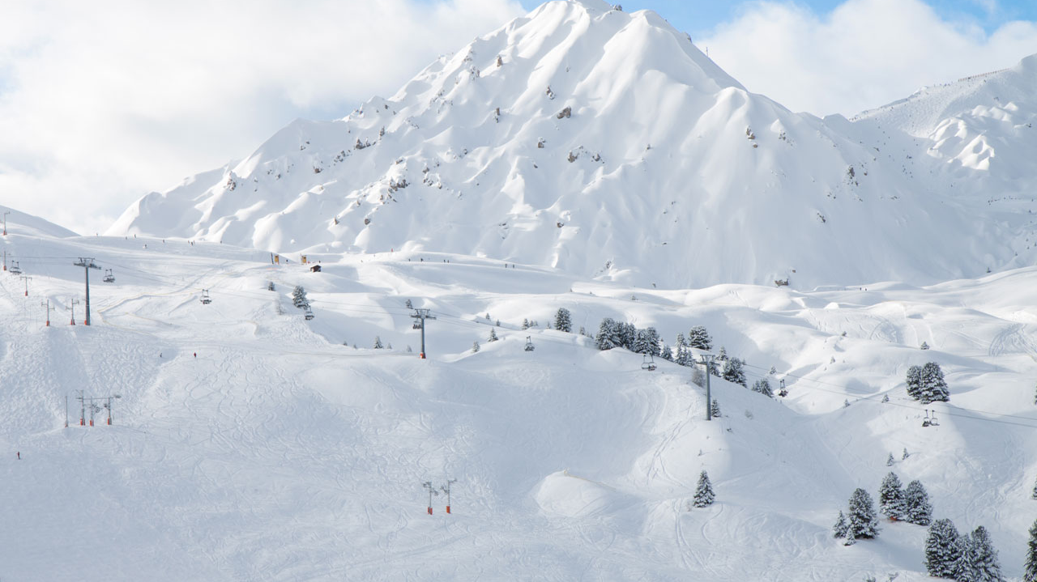
Outline
The main goal of this project was to design a web application that allows users to search a database of ski resorts and view a list of suggested destinations based off of their preference.
Many current travel applications on line have a broad range of destinations but we wanted ours to be more specialized and give people who wanted an in depth skiing experience the information they needed.
Side goals: Learn some cool coding stuff

Slide 3




Schematic
HTML Web Page
SQL Database
Google Maps
API
Web Scraping
(On the Snow)
Weather
API
(Open Weather Map)
Preference Algorithm/Query Requests
HTML Web Page
Django

Slide 4

Interesting Aspects
Weather API
Google Maps API
Resort Descriptions Web Scraping
Preference Algorithm

Slide 5
Demo Time!

Slide 6

Challenges & Surprises
Data Collection
Our guy didn’t deliver
We had to scrape through a website to build our own dataset
Had to manually input some information
Algorithm Structuring
We had a lot of different ideas on what would work
Had a difficult time giving the correct weights based off the users inputs
Ultimately we came up with a scoring system that we are still trying to improve to make more accurate
Output
We wanted to output a detailed description of information to the user but had a difficult time returning multiple results as it overloaded the user with information
We decided to just return at most 3 with a vast amount of information on these given resorts
If the user doesn’t like his options he can always go back and do the search again.

Slide 7
Future
Improve Preference Algorithm
Run more tests to make sure location information is correct
Use CSS to update website

